Slide 1
Discrete Mathematics and Its Application 7th edition, 2001
Kenneth H. Rosen

Slide 2
Welcome to Discrete Mathematics Spring 2018
Instructor: Niu Shao Zhang

Slide 3
Chapter 6 Counting
Chapter Summary
The Basics of Counting
The Pigeonhole Principle
Permutations and Combinations
Binomial Coefficients and Identities
Generalized Permutations and Combinations
Generating Permutations and Combinations (not yet included in overheads)

Slide 4
§6.1 The Basics of Counting
Section Summary
The Product Rule
The Sum Rule
The Subtraction Rule
The Division Rule
Examples, Examples, and Examples
Tree Diagrams

Slide 5
Basic Counting Principles: The Product Rule
The Product Rule: A procedure can be broken down into a sequence of two tasks. There are n₁ ways to do the first task and n₂ ways to do the second task. Then there are n₁∙n₂ ways to do the procedure.
Example: How many bit strings of length seven are there?
Solution: Since each of the seven bits is either a 0 or a 1, the answer is 2⁷ = 128.

Slide 6
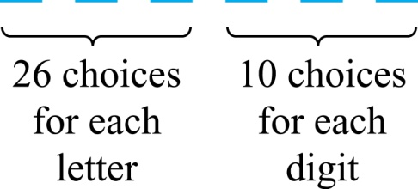
The Product Rule
Example: How many different license plates（车牌） can be made if each plate contains a sequence of three uppercase English letters followed by three digits?
Solution: By the product rule,
there are 26 ∙ 26 ∙ 26 ∙ 10 ∙ 10 ∙ 10 = 17,576,000 different possible license plates.

Slide 7
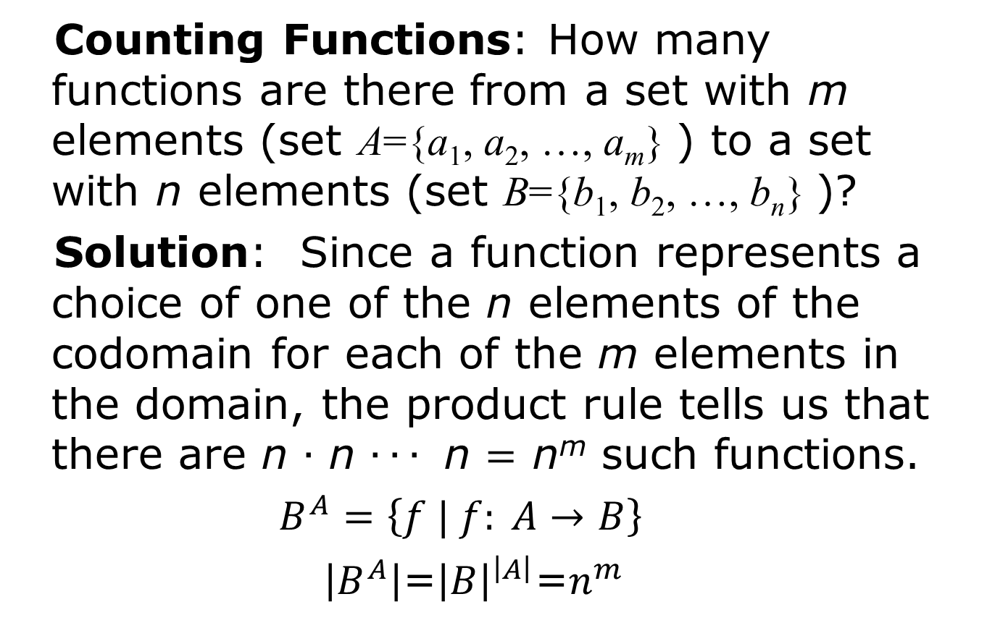
Counting Functions
Counting Functions: How many functions are there from a set with m elements (set A={a₁, a₂, …, a_{m}} ) to a set with n elements (set B={b₁, b₂, …, b_{n}} )?
Solution: Since a function represents a choice of one of the n elements of the codomain for each of the m elements in the domain, the product rule tells us that there are n ∙ n ∙ ∙ ∙ n = n^{m} such functions.
$B^{A}=\left\{f | f: A→B\right\}$
$\left|B^{A}\right|$=${\left|B\right|}^{\left|A\right|}$=$n^{m}$

Slide 8
Counting Functions
Counting One-to-One Functions: How many one-to-one functions are there from a set with m elements to one with n elements?
Solution: Suppose the elements in the domain are a₁, a₂, …, a_{m}. There are n ways to choose the value of a₁ and n−1 ways to choose a₂, etc. The product rule tells us that there are
n(n−1) (n−2)∙∙∙(n−m +1)
such functions.

Slide 9
Telephone Numbering Plan
Example: The North American numbering plan (NANP) specifies that a telephone number consists of 10 digits, consisting of a three-digit area code, a three-digit office code, and a four-digit station code. There are some restrictions on the digits.
Let X denote a digit from 0 through 9.
Let N denote a digit from 2 through 9.
Let Y denote a digit that is 0 or 1.
In the old plan (in use in the 1960s) the format was NYX-NNX-XXX.
In the new plan, the format is NXX-NXX-XXX.
How many different telephone numbers are possible under the old plan and the new plan?
Solution: Use the Product Rule.
There are 8 ∙2 ∙10 = 160 area codes with the format NYX.
There are 8 ∙10 ∙10 = 800 area codes with the format NXX.
There are 8 ∙8 ∙10 = 640 office codes with the format NNX.
There are 10 ∙10 ∙10 ∙10 = 10,000 station codes with the format XXXX.
Number of old plan telephone numbers: 160 ∙640 ∙10,000 = 1,024,000,000.
Number of new plan telephone numbers: 800 ∙800 ∙10,000 = 6,400,000,000.

Slide 10
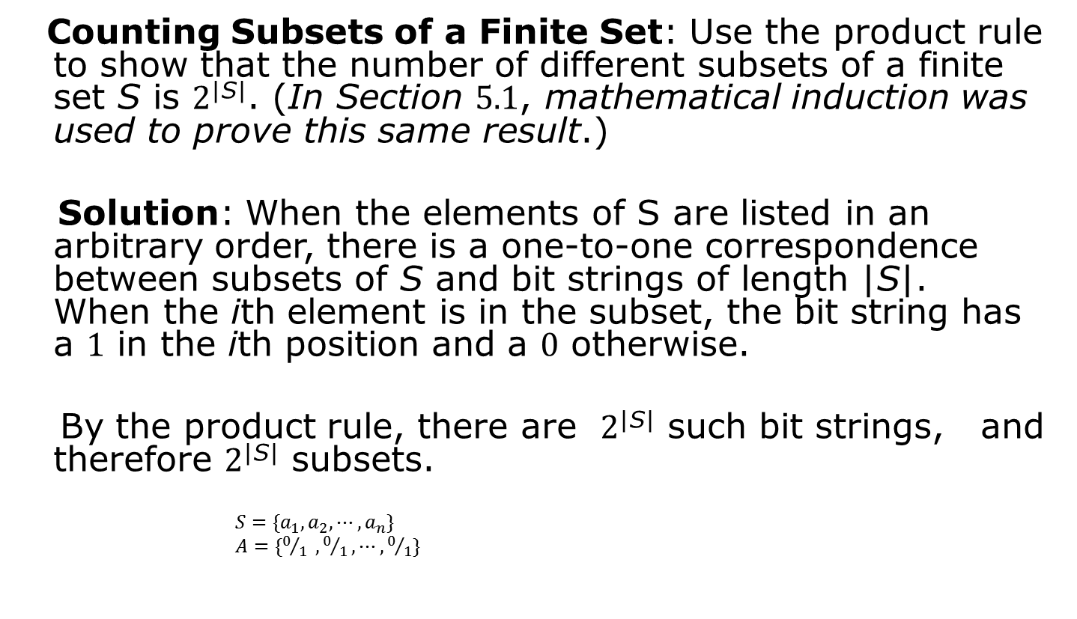
Counting Subsets of a Finite Set
Counting Subsets of a Finite Set: Use the product rule to show that the number of different subsets of a finite set S is 2^{|S|}. (In Section 5.1, mathematical induction was used to prove this same result.)
Solution: When the elements of S are listed in an arbitrary order, there is a one-to-one correspondence between subsets of S and bit strings of length |S|. When the ith element is in the subset, the bit string has a 1 in the ith position and a 0 otherwise.
By the product rule, there are 2^{|S|} such bit strings, and therefore 2^{|S|} subsets.
$S=\{a_{1},a_{2}, ⋯,a_{n}\}$
$A=\{0/1 ,0/1,⋯,0/1\}$

Slide 11
Product Rule in Terms of Sets
If A₁, A₂, … , A_{m} are finite sets, then the number of elements in the Cartesian product of these sets is the product of the number of elements of each set.
The task of choosing an element in the Cartesian product A₁ ⨉ A₂ ⨉ ∙∙∙ ⨉ A_{m} is done by choosing an element in A₁, an element in A₂ , …, and an element in A_{m}.
By the product rule, it follows that:
|A₁ ⨉ A₂ ⨉ ∙∙∙ ⨉ A_{m} |= |A₁| ∙ |A₂| ∙ ∙∙∙ ∙ |A_{m}|.

Slide 12
DNA and Genomes
A gene is a segment of a DNA molecule that encodes a particular protein and the entirety of genetic information of an organism is called its genome.
DNA molecules consist of two strands of blocks known as nucleotides. Each nucleotide is composed of bases: adenine (A), cytosine (C), guanine (G), or thymine (T).
The DNA of bacteria has between 10⁵ and 10⁷ links (one of the four bases). Mammals have between 10⁸ and 10¹⁰ links. So, by the product rule there are at least 4¹⁰⁵ different sequences of bases in the DNA of bacteria and 4¹⁰⁸ different sequences of bases in the DNA of mammals.
The human genome includes approximately 23,000 genes, each with 1,000 or more links.
Biologists, mathematicians, and computer scientists all work on determining the DNA sequence (genome) of different organisms.

Slide 13
Basic Counting Principles: The Sum Rule
The Sum Rule: If a task can be done either in one of n₁ ways or in one of n₂ ways to do the second task, where none of the set of n₁ ways is the same as any of the n₂ ways, then there are n₁ + n₂ ways to do the task.

Slide 14
Basic Counting Principles: The Sum Rule
Example: The mathematics department must choose either a student or a faculty member as a representative for a university committee. How many choices are there for this representative if there are 37 members of the mathematics faculty and 83 mathematics majors and no one is both a faculty member and a student.
Solution: By the sum rule it follows that there are 37 + 83 = 120 possible ways to pick a representative.

Slide 15
The Sum Rule in terms of sets.
The sum rule can be phrased in terms of sets.
|A ∪ B|= |A| + |B| as long as A and B are disjoint sets.
Or more generally,
The case where the sets have elements in common will be discussed when we consider the subtraction rule and taken up fully in Chapter 8.
|A₁ ∪ A₂ ∪ ∙∙∙ ∪ A_{m} |= |A₁| + |A₂| + ∙∙∙ + |A_{m}|
when A_{i} ∩ A_{j} = ∅ for all i, j.

Slide 16
Combining the Sum and Product Rule
Example: Suppose statement labels(变量名称) in a programming language can be either a single letter or a letter followed by a digit. Find the number of possible labels.
Solution: Use the product rule.
26 + 26 ∙ 10 = 286

Slide 17
Counting Passwords
Combining the sum and product rule allows us to solve more complex problems.
Example: Each user on a computer system has a password, which is six to eight characters long, where each character is an uppercase letter or a digit. Each password must contain at least one digit. How many possible passwords are there?
Solution: Let P be the total number of passwords, and let P₆, P₇, and P₈ be the passwords of length 6, 7, and 8.
By the sum rule P = P₆ + P₇ +P₈.
To find each of P₆, P₇, and P₈ , we find the number of passwords of the specified length composed of letters and digits and subtract the number composed only of letters. We find that:
P₆ = 36⁶ − 26⁶ =2,176,782,336 − 308,915,776 =1,867,866,560.
P₇ = 36⁷ − 26⁷ =
78,364,164,096 − 8,031,810,176 = 70,332,353,920.
P₈ = 36⁸ − 26⁸ =
2,821,109,907,456 − 208,827,064,576 =2,612,282,842,880.
Consequently, P = P₆ + P₇ +P₈ = 2,684,483,063,360.

Slide 18
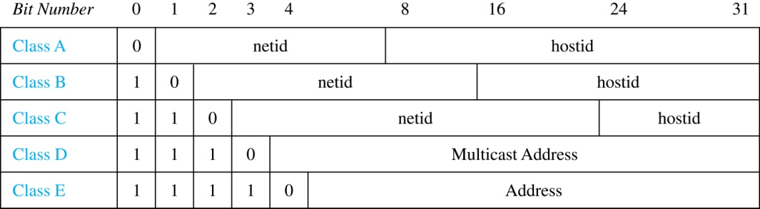
Internet Addresses
Version 4 of the Internet Protocol (IPv4) uses 32 bits.
Class A Addresses: used for the largest networks, a 0,followed by a 7-bit netid and a 24-bit hostid.
Class B Addresses: used for the medium-sized networks, a 10,followed by a 14-bit netid and a 16-bit hostid.
Class C Addresses: used for the smallest networks, a 110,followed by a 21-bit netid and a 8-bit hostid.
Neither Class D nor Class E addresses are assigned as the address of a computer on the internet. Only Classes A, B, and C are available.
1111111 is not available as the netid of a Class A network.
Hostids consisting of all 0s and all 1s are not available in any network.

Slide 19
Counting Internet Addresses
Example: How many different IPv4 addresses are available for computers on the internet?
Solution: Use both the sum and the product rule. Let x be the number of available addresses, and let x_{A}, x_{B}, and x_{C} denote the number of addresses for the respective classes.
To find, x_{A}: 2⁷ − 1 = 127 netids. 2²⁴ − 2 = 16,777,214 hostids.
x_{A} = 127∙ 16,777,214 = 2,130,706,178.
To find, x_{B}: 2¹⁴ = 16,384 netids. 2¹⁶ − 2 = 16,534 hostids.
x_{B} = 16,384 ∙ 16, 534 = 1,073,709,056.
To find, x_{C}: 2²¹ = 2,097,152 netids. 2⁸ − 2 = 254 hostids.
x_{C} = 2,097,152 ∙ 254 = 532,676,608.
Hence, the total number of available IPv4 addresses is
x = x_{A} + x_{B} + x_{C}
= 2,130,706,178 + 1,073,709,056 + 532,676,608
= 3, 737,091,842.
Not Enough Today !!
The newer IPv6 protocol solves the problem of too few addresses.

Slide 20
Basic Counting Principles: Subtraction Rule
Subtraction Rule: If a task can be done either in one of n₁ ways or in one of n₂ ways, then the total number of ways to do the task is n₁ + n₂ minus the number of ways to do the task that are common to the two different ways.
Also known as, the principle of inclusion-exclusion:

Slide 21
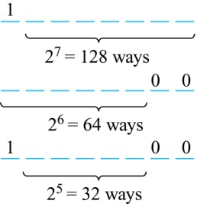
Counting Bit Strings
Example: How many bit strings of length eight either start with a 1 bit （Set A） or end with the two bits 00 （Set B）?
Solution: Use the subtraction rule.
Number of bit strings of length eight that start with a 1 bit: 2⁷ = 128
Number of bit strings of length eight that start with bits 00: 2⁶ = 64
Number of bit strings of length eight that start with a 1 bit and end with bits 00 : 2⁵ = 32
Hence, the number is 128 + 64 − 32 = 160.

Slide 22
Basic Counting Principles: Division Rule
Division Rule: There are n/d ways to do a task if it can be done using a procedure that can be carried out in n ways, and for every way w, exactly d of the n ways correspond to way w.
Restated in terms of sets: If the finite set A is the union of n pairwise disjoint （两两不交）subsets each with d elements, then n = |A|/d.
In terms of functions: If f is a function from A to B, where both are finite sets, and for every value y ∈ B there are exactly d values x ∈ A such that f(x) = y, then |B| = |A|/d.

Slide 23
Basic Counting Principles: Division Rule
Example: How many ways are there to seat four people around a circular table, where two seatings are considered the same when each person has the same left and right neighbor?
Solution: Number the seats around the table from 1 to 4 proceeding clockwise. There are four ways to select the person for seat 1, 3 for seat 2, 2, for seat 3, and one way for seat 4. Thus there are 4! = 24 ways to order the four people. But since two seatings are the same when each person has the same left and right neighbor, for every choice for seat 1, we get the same seating.
Therefore, by the division rule, there are 24/4 = 6 different seating arrangements.

Slide 24
Tree Diagrams
Tree Diagrams: We can solve many counting problems through the use of tree diagrams, where a branch represents a possible choice and the leaves represent possible outcomes.
Example: Suppose that “I Love Discrete Math” T-shirts come in five different sizes: S,M,L,XL, and XXL. Each size comes in four colors (white, red, green, and black), except XL, which comes only in red, green, and black, and XXL, which comes only in green and black. What is the minimum number of stores that the campus book store needs to stock to have one of each size and color available?
假如“我爱离散数学”的T恤衫有5个型号， S,M,L,XL, and XXL
每个型号有4个颜色（白色、红色、绿色和黑色），但XL只有红色、绿色和黑色， XXL只有绿色和黑色。

Slide 25
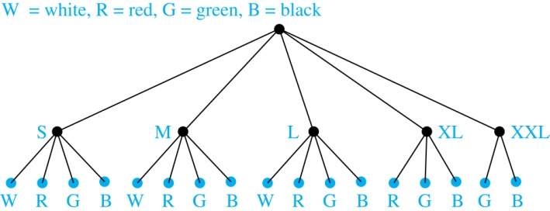
Tree Diagrams
Example: Suppose that “I Love Discrete Math” T-shirts come in five different sizes: S,M,L,XL, and XXL. Each size comes in four colors (white, red, green, and black), except XL, which comes only in red, green, and black, and XXL, which comes only in green and black. What is the minimum number of stores that the campus book store needs to stock to have one of each size and color available?
Solution: Draw the tree diagram.
The store must stock 17 T-shirts.

Slide 26
Homework
§6.1
46, 50

Slide 27
§ 6.2 The Pigeonhole Principle
Section Summary
The Pigeonhole Principle
The Generalized Pigeonhole Principle

Slide 28
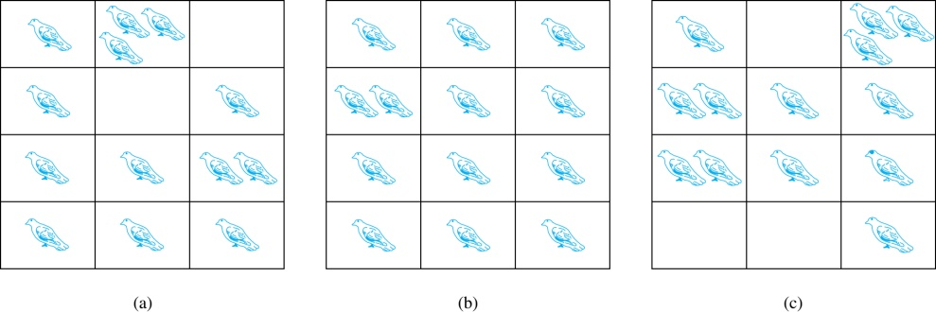
The Pigeonhole Principle
If a flock of 20 pigeons roosts in a set of 19 pigeonholes, one of the pigeonholes must have more than 1 pigeon.
Pigeonhole Principle: If k is a positive integer and k + 1 objects are placed into k boxes, then at least one box contains two or more objects.
Proof: We use a proof by contraposition. Suppose none of the k boxes has more than one object. Then the total number of objects would be at most k. This contradicts the statement that we have k + 1 objects.

Slide 29
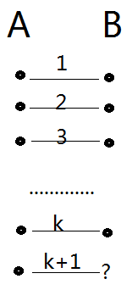
The Pigeonhole Principle
Corollary 1: A function f from a set with k + 1 elements to a set with k elements is not one-to-one.
Proof: Use the pigeonhole principle.
Create a box for each element y in the codomain of f .
Put in the box for y all of the elements x from the domain such that f(x) = y.
Because there are k + 1 elements and only k boxes, at least one box has two or more elements.
Hence, f can’t be one-to-one.

Slide 30
Pigeonhole Principle
Example: Among any group of 367 people, there must be at least two with the same birthday, because there are only 366 possible birthdays.
一年最多366天

Slide 31

Pigeonhole Principle
Example (optional): Show that for every integer n there is a multiple of n that has only 0s and 1s in its decimal expansion.
Solution: Let n be a positive integer. Consider the n + 1 integers 1, 11, 111, …., 11…1 (where the last has n + 1 1s). There are n possible remainders when an integer is divided by n. By the pigeonhole principle, when each of the n + 1 integers is divided by n, at least two must have the same remainder. Subtract the smaller from the larger and the result is a multiple of n that has only 0s and 1s in its decimal expansion.
余数相同的两个数a和b(a>b)相减后，a-b仍能被n整除，且a-b 只有0和1

Slide 32
A Specific Case
Let n=3. Consider 1, 11, 111, 1111.
1 mod 3 = 1
11 mod 3 = 2
111 mod 3 = 0 ⬅ Lucky extra solution.
1,111 mod 3 = 1
1,111 − 1 = 1,110 = 3·370.
It has only 0’s and 1’s in its expansion.
Its residue mod 3 = 0, so it’s a multiple of 3.
Note same residue.

Slide 33
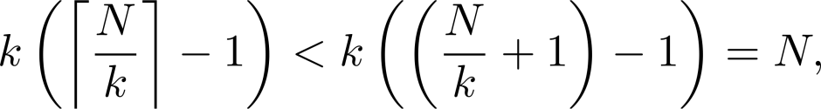
The Generalized Pigeonhole Principle
The Generalized Pigeonhole Principle: If N objects are placed into k boxes, then there is at least one box containing at least ⌈N/k⌉ objects.
Proof: We use a proof by contraposition. Suppose that none of the boxes contains more than ⌈N/k⌉ − 1 objects. Then the total number of objects is at most
where the inequality ⌈N/k⌉ < ⌈N/k⌉ + 1 has been used. This is a contradiction because there are a total of n objects.
N个物体放入k个盒子，N=q*k+r, 0<r<k,则至少有一个盒子有q+1个物体

Slide 34
The Generalized Pigeonhole Principle
Example: Among 100 people there are at least ⌈100/12⌉ = 9 who were born in the same month.
若每个月生日相同的人都少于9，则8*12=96<100

Slide 35
⎡N/k⎤≥r asks samllest N
A common type of problem asks for the minimum number of objects such that at least r of these objects must be in one of k boxes when these objects are distributed among the boxes.
Solution: ⎡N/k⎤ ≥r. so N/k > r−1,
N > k(r-1)
N = k(r−1)+1 is the smallest integer.

Slide 36
The Generalized Pigeonhole Principle
Example: a) How many cards must be selected from a standard deck of 52 cards to guarantee that at least three cards of the same suit are chosen?
b) How many must be selected to guarantee that at least three hearts are selected?
Solution: a) We assume four boxes（k=4）; one for each suit. Using the generalized pigeonhole principle, at least one box contains at least ⌈N/4⌉ cards. At least three cards of one suit are selected if ⌈N/4⌉ ≥3. The smallest integer N such that ⌈N/4⌉ ≥3 is The smallest integer N such that ⌈N/4⌉ ≥3 is N = k(r−1)+1= 4 ∙ (3-1) + 1 = 2 ∙ 4 + 1 = 9.

Slide 37
The Generalized Pigeonhole Principle
Example: a) How many cards must be selected from a standard deck of 52 cards to guarantee that at least three cards of the same suit are chosen?
b) How many must be selected to guarantee that at least three hearts are selected?
Solution: b) A deck contains 13 hearts and 39 cards which are not hearts. So, if we select 41 cards, we may have 39 cards which are not hearts along with 2 hearts. However, when we select 42 cards, we must have at least three hearts. (Note that the generalized pigeonhole principle is not used here.)

Slide 38
Another Fun Example
Suppose that next June, the Marlins baseball team plays at least 1 game a day, but ≤45 games total. Show there must be some sequence of consecutive days in June during which they play exactly 14 games.
假设在6月份（30天），马林斯棒球队每天至少打一次比赛，但至多45次比赛，证明在6月一定有连续的若干天内，恰好打了14次比赛。

Slide 39
Baseball problem illustrated
Example of {a_{i}}: Note all elements are distinct.
1, 2, 4, 5, 7, 8, 10, 11, 13, 14, 16, 17, 19, 21, 22, 23, 25, 27, 29, 30, 31, 33, 34, 36, 37, 39, 40, 41, 43, 45
Then {a_{i}+14} is the following sequence: 15, 16, 18, 19, 21, 22, 24, 25, 27, 28, 30, 32, 33, 35, 36, 37, 39, 41, 43, 44, 45, 47, 48, 50, 51, 53, 54, 55, 57, 59
In any 60 integers from 1-59 there must be some duplicates, indeed we find the following ones:
16, 19, 21, 22, 25, 27, 30, 33, 36, 37, 39, 41, 43, 45
Thus, for example, exactly 14 games were played during days 3 to 11: 2+1+2+1+2+1+2+1+2

Slide 40
Another Fun Example
Suppose that next June, the Marlins baseball team plays at least 1 game a day, but ≤45 games total. Show there must be some sequence of consecutive days in June during which they play exactly 14 games.
Proof: Let a_{j} be the number of games played on or before day j. Then, a₁,…,a₃₀ ∈ Z⁺ is a sequence of 30 distinct integers with 1 ≤ a_{j} ≤ 45. Therefore a₁+14,…,a₃₀+14 is a sequence of 30 distinct integers with 15 ≤ a_{j}+14 ≤ 59. Thus, (a₁,…,a₃₀,a₁+14,…,a₃₀+14) is a sequence of 60 integers from the set {1,..,59}. By the Pigeonhole Principle, two of them must be equal, but a_{i}≠a_{j} for i≠j. So, ∃ij: a_{i} = a_{j}+14. Thus, 14 games were played on days a_{j}+1, …, a_{i}.

Slide 41
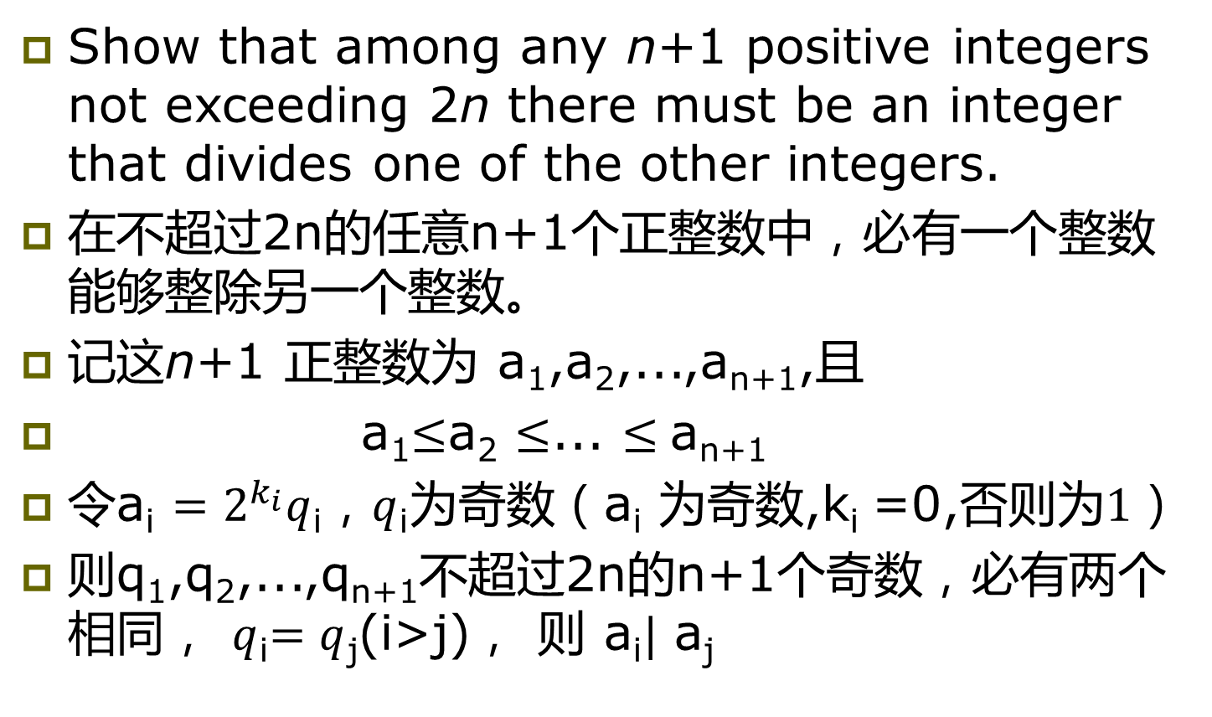
Example
Show that among any n+1 positive integers not exceeding 2n there must be an integer that divides one of the other integers.
在不超过2n的任意n+1个正整数中，必有一个整数能够整除另一个整数。
记这n+1 正整数为 a₁,a₂,...,a_{n+1},且
a₁$≤$a₂ $≤$... $≤$a_{n+1}
令a_{i} $=2^{k_{i}}q$_{i}，$q$_{i}为奇数（a_{i} 为奇数,k_{i} =0,否则$为1$）
则q₁,q₂,...,q_{n+1}不超过2n的n+1个奇数，必有两个相同， $q$_{i}$=q$_{j}(i>j)， 则 a_{i}$|$ a_{j}

Slide 42
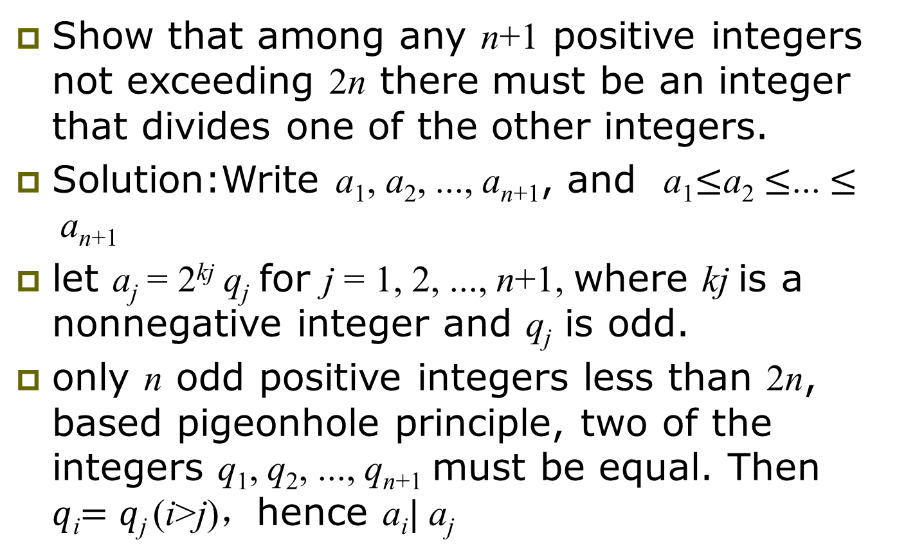
Example
Show that among any n+1 positive integers not exceeding 2n there must be an integer that divides one of the other integers.
Solution:Write a₁, a₂, ..., a_{n+1}, and a₁$≤$a₂ $≤$... $≤$a_{n+1}
let a_{j} = 2^{kj} q_{j} for j = 1, 2, ..., n+1, where kj is a nonnegative integer and q_{j} is odd.
only n odd positive integers less than 2n, based pigeonhole principle, two of the integers q₁, q₂, ..., q_{n+1} must be equal. Then $q$_{i}$=q$_{j} (i>j)，hence a_{i}$|$ a_{j}

Slide 43
Definition
Suppose that a₁,a₂,…a_{n} is a sequence of real numbers. A subsequence (子序列) of this sequence is a sequence of the form a_{i1},a_{i2},…a_{im} ,where 1≤ i₁<i₂<…<i_{m} ≤N.
A sequence is called strictly increasing（严格递增） if each term is larger than the one that precedes it.
A sequence is called strictly decreasing （严格递减）if each term is smaller than the one that precedes it.

Slide 44
Theorem 3
Every sequence of n²+1 distinct real number contains a subsequence of length n+1 that is either strictly increasing or strictly decreasing.
n²+1个不同实数构成的序列中，至少存在一个长度为n+1的严格递增或严格递减的序列。

Slide 45
A Specific Case
一个含有10（10=3²+1）项的数列 {a_{k}}
8, 11, 9, 1, 4, 6, 12, 10, 5, 7
中含有长度为4的严格递增序列 1, 4, 6,12
还有哪些严格递增序列 或 严格递减序列？
记 i_{k} 为从a_{k}开始的最长严格递增序列的长度，d_{k} 为从a_{k}开始的最长严格递减序列的长度，对于上面的序列
8, 11, 9, 1, 4, 6, 12, 10, 5, 7
i_{k} 3 2 2 4 3 2 1 1 2 1
d_{k} 3 4 3 1 1 2 3 2 1 1
没有两个有序对（ i_{k} , d_{k} ）是一样的

Slide 46
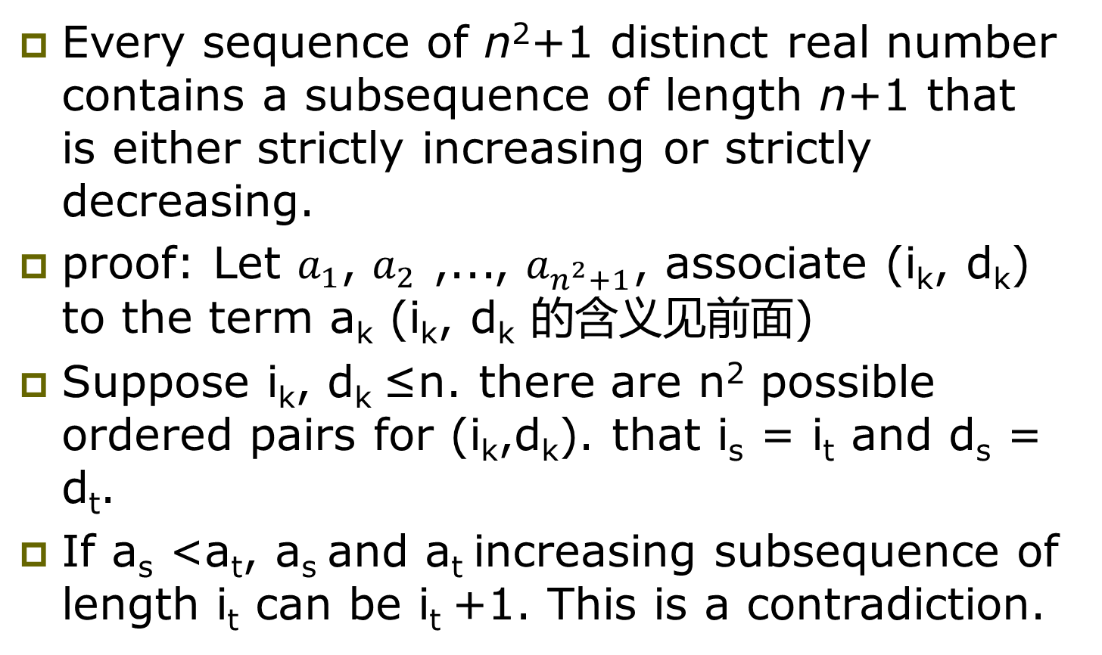
Theorem 3
Every sequence of n²+1 distinct real number contains a subsequence of length n+1 that is either strictly increasing or strictly decreasing.
proof: Let $a_{1}$, $a_{2}$ ,..., $a_{n^{2}+1}$, associate (i_{k}, d_{k}) to the term a_{k} (i_{k}, d_{k} 的含义见前面)
Suppose i_{k}, d_{k} ≤n. there are n² possible ordered pairs for (i_{k},d_{k}). that i_{s} = i_{t} and d_{s} = d_{t}.
If a_{s} <a_{t}, a_{s} and a_{t} increasing subsequence of length i_{t} can be i_{t} +1. This is a contradiction.

Slide 47
The Ramsey number R(m,n) 拉姆齐数
Example 13: Assume that in a group of six people, each pair of individuals consists of two friends or two enemies. Show that there are either three mutual friends or three mutual enemies in the group. (R(3,3)=6)
在一个6个人的组中，任意取两个人，则这两人或是朋友或是敌人。证明在这6人组中，存在3个人要么是朋友要么是敌人。
拉姆齐数R(m,n)
假设晚会上每两个人是朋友或者是敌人，那么在一个晚会上使得或者有m个人两两是朋友，或者n个人两两敌人，所需要的最小人数为R(m,n)
R(3,3)=6

Slide 48
The Ramsey number R(m,n)
Example 13:Assume that in a group of six people, each pair of individuals consists of two friends or two enemies. Show that there are either three mutual friends or three mutual enemies in the group. (R(3,3)=6)
Solution: Let A be one of the six people. from the generalized pigeonhole principle, ﬁve objects are divided into two sets, one of the sets has at least ⌈5/2⌉ ≥ 3 elements.
Case1: suppose that B, C, and D are friends of A.
If any two of these three individuals are friends, then these two and A form a group of three mutual friends. (如果3个人中任2个是A的朋友，加A则3人)
Otherwise, B, C, and D form a set of three mutual enemies. (否则3个人中任2个是敌人)

Slide 49
Homework
§6.2
12, 26, 46

